Slide 1
Inclusion criteria and long-term results of bilateral presbyopia correction by SUPRACOR method
Anisimova S.Yu, Anisimov S.I., Anisimova N.S., Semyonov S.V.,
Novak I.V., Fastovtsova L.G.
Eye center VOSTOK-PROZRENIE, Moscow, Russia
No financial interest

Slide 2
Purpose
To determine inclusion criteria and evaluate long-term results of SUPRACOR treatment, performed bilaterally in cases of presbyopia with ametropia

Slide 3
Materials and methods
92 patients (182 eyes): presbyopia combined with hyperopia. Observation period 6 years
16 patients (32 eyes): presbyopia combined with myopia. Observation period 3 years

Slide 4
SUPRACOR: preoperative examination
Subjective and cycloplegic refraction
Corrected and uncorrected monocular and binocular distance vision acuity
Corrected and uncorrected monocular and binocular near vision acuity
Corneal topography examination
Aberrometry
Simulation test

Slide 5
SUPRACOR inclusion criteria for all patients
44 – 60 years old
Sph from +0.25 D to + 5.0D
Sph from -2.0 D to -5.0D
Cyl up 2.0 D
Angle Kappa not more than 10 degrees
Best corrected distance vision acuity 0.1 - 0.0 (logmar)
Difference between subjective and cycloplegic refraction 0.75 D and less
Near vision addition + 1.5 D and more.
Photopic pupil diameter not more than 2.9 mm.
Mesopic pupil diameter not more than 6.5 mm.
No LASIK contraindications

Slide 6
SUPRACOR simulation test
Simulation test of post/op distance vision acuity:
Add sph+0.5 to best correction of distance vision.
“so the distance vision may look like after the surgery”
If the patient doesn’t like the result=>do not perform SUPRACOR!

Slide 7
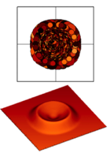
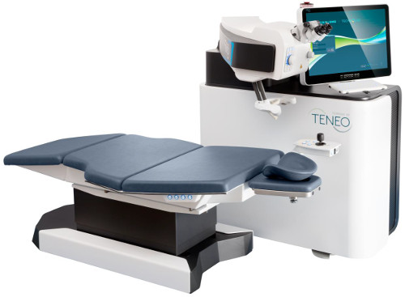
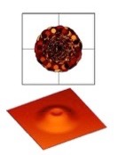
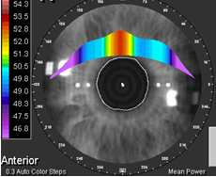
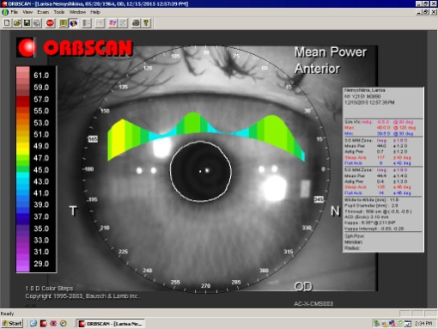
SUPRACOR: LASIK–based, aberration optimized, multifocal
Hyperopic
SUPRACOR
Myopic
SUPRACOR
Operation equipment
Excimer lasers Technolaz 217 Z100 and Teneo 317
(“Bausch &Lomb”)

Slide 8
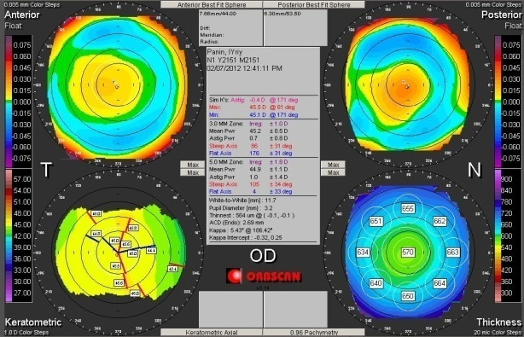
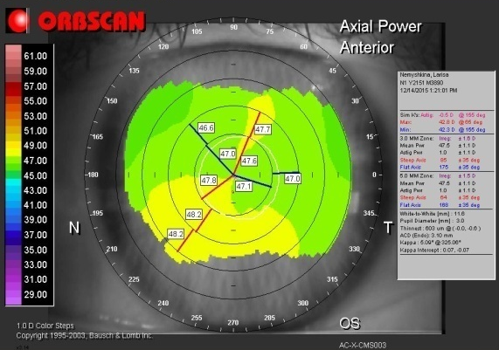
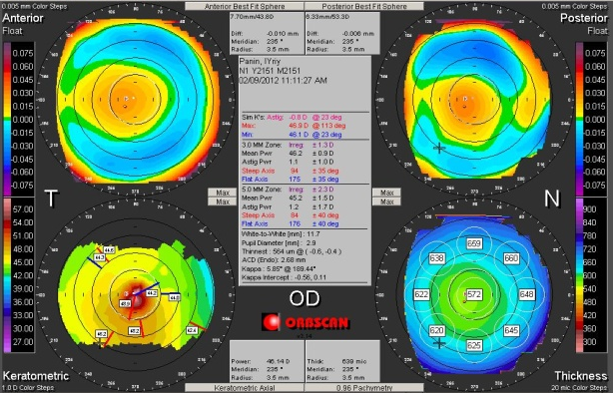
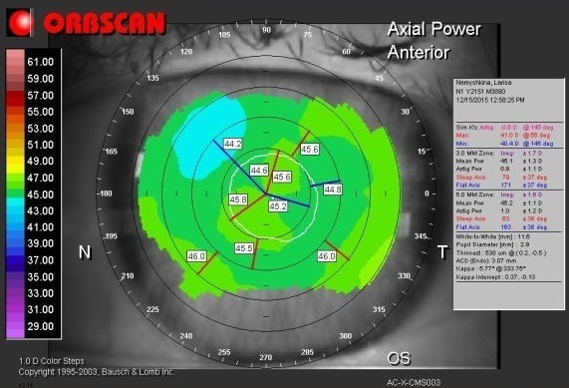
SUPRACOR: pre/op and post/op keratotopography
Presbyopia and hyperopia
Presbyopia and myopia
preop
postop

Slide 9
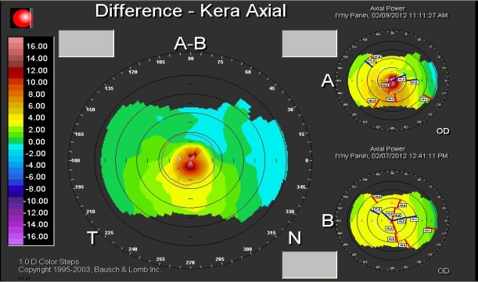
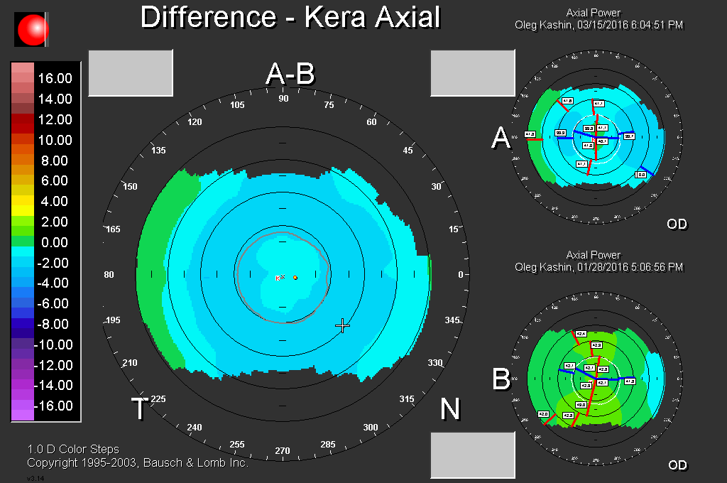
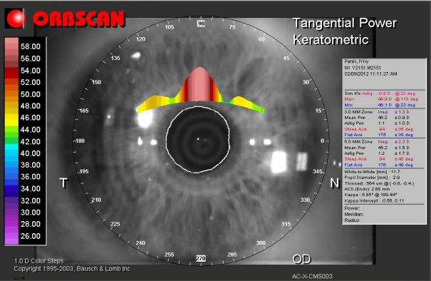
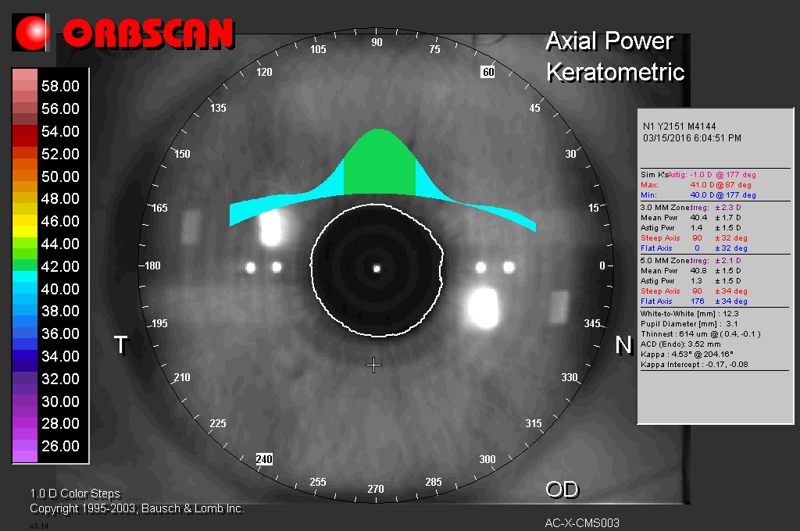
SUPRACOR: post/op keratotopography difference
Presbyopia and hyperopia
Presbyopia and myopia
.

Slide 10
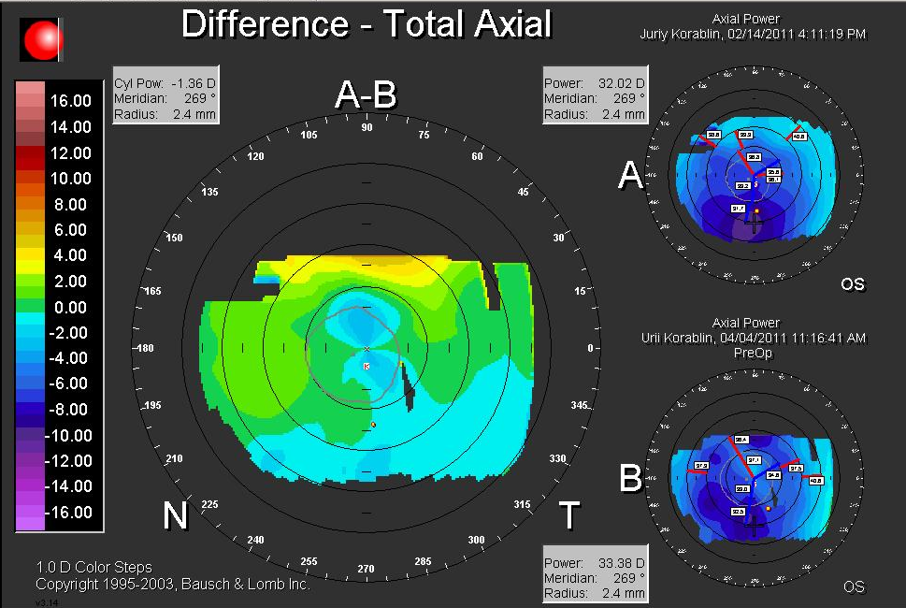
Differencial Keratotopography before and after SUPRACOR (RK 25 years before)
VA before SUPRACOR 0,7 sph +1,75D, cyl +1,25D =0,2 (logmar)
VA post/op DVA 0,1 sph-0,75=0,0, NVA 0,3

Slide 11
Uncorrected binocular distance visual acuity after SUPRACOR in cases of presbyopia + hyperopia 92 patients (182 eyes)
%
0.0
0.05
0.1
0.18
0.3
0.54
1.0
converted from decimal to logmar

Slide 12
Uncorrected binocular near vision acuity after SUPRACOR in cases of presbyopia + hyperopia 92 patients (182 eyes)
%
0.0
0.05
0.1
0.18
0.3
0.54
1.0
1.3
converted from decimal to logmar

Slide 13
Uncorrected binocular distance vision acuity after SUPRACOR in cases of presbyopia + myopia 16 patients (32 eyes)
%
0.0
0.05
0.1
0.18
0.3
0.54
1.0
1.3
converted from decimal to logmar

Slide 14
Uncorrected binocular near vision acuity after SUPRACOR in cases of presbyopia + myopia 16 patients (32 eyes)
%
0.0
0.05
0.1
0.18
converted from decimal to logmar

Slide 15
Conclusions
Based on LASIK, SUPRACOR shows safe and predictable results when performed bilaterally in cases of presbyopia combined with hyperopia or myopia
It is a good choice for patients who don’t want to be treated with more invasive procedure of refractive lens exchange.
SUPRACOR appeared to be a successful method of hyperopic shift correction in patients with previously performed anterior radial keratotomy
The correct choice of patient is very important.

Slide 16
Thank you for your attention!

